Slide 1

\
Climate Variability and Infant Mortality

Slide 2
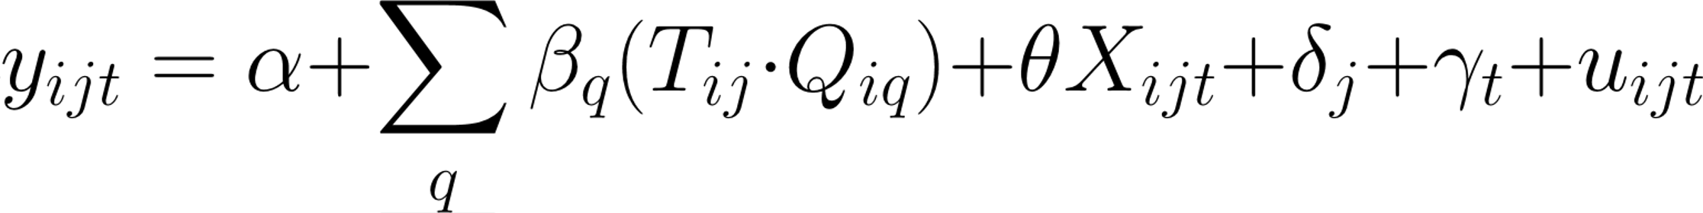
The Question
How does exposure to weather shocks, either in-utero or during the first year of life, affect the likelihood of survival?
Identification Approach: stepped
where y is a dummy variable equal to 1 if the child i living in district j born in year t died, T indicates whether the household was affected by a climate shock, Q are seven dummy variables representing the age of the child (each quarter in utero and until the first age). X is a set of controls, and delta and gamma are fixed effects for district and year of birth.

Slide 3
What DATA do we have?
DHS | Climate Data
 | (CRU, ERA5)
60 countries | Worldwide coverage
Years 1998 to 2021 | Years 1950 to 2020
Annual | Monthly
Geo-located data is displaced up to 5 km (0-2 km urban, 0-5 km rural) | 0.5 x 0.5 gridded satellite data (~50km in equator, ~65km next to poles)
Mortality data for the first four quarters of life and three quarters of gestation of the mother | 5 weather shocks (Drought, Excessive rain, Intense rain, Heatwave, Cold wave)

Slide 4
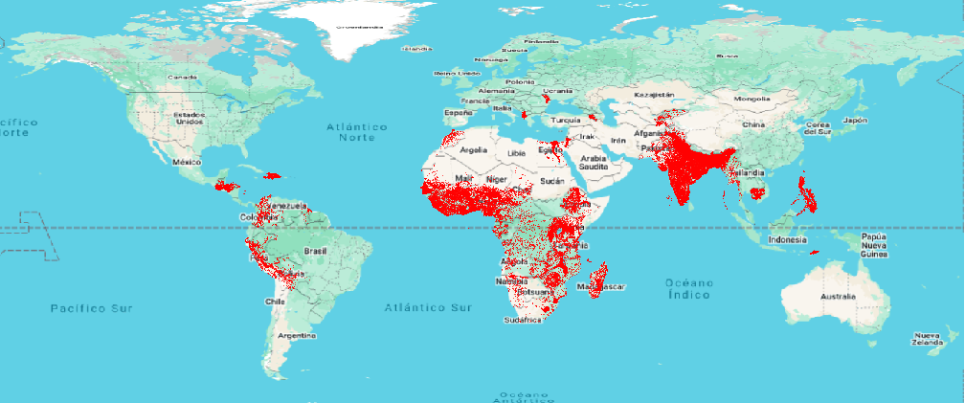

DHS data coverage
Legend:
Warm Spell index in 2004
(>6 consecutive days with temperature greater than 40°)
28
0
Household in DHS

Slide 5
Weather shock definitions
Droughts:
Year cumulative precipitation lower than historical average minus 2 or 2.5 standard deviations, considering 15 or 50 years to estimate historical average and SD. Potentially we may include a measure including SPI.
Excessive Rain:
Year cumulative precipitation higher than historical average plus 2 or 2.5 standard deviations, considering 15 or 50 years to estimate historical average and SD.
Intense Rain:
Cumulative 1- or 5-days precipitation exceeding 100, 200, 300, 400 or 600 millimeters.
Cold wave:
Number of days with maximum or minimum temperature below 0 degrees is over 6 and higher than historical average plus 2 or 2.5 standard deviations, considering 50 years to estimate historical average and SD. Furthermore, cold spell duration index is higher than 6 days.
Heat wave:
Number of days with maximum temperature above 35 or 40 degrees is over 6 and higher than historical average plus 2 or 2.5 standard deviations, considering 50 years to estimate historical average and SD. Furthermore, warm spell duration index is higher than 6 days.

Slide 6
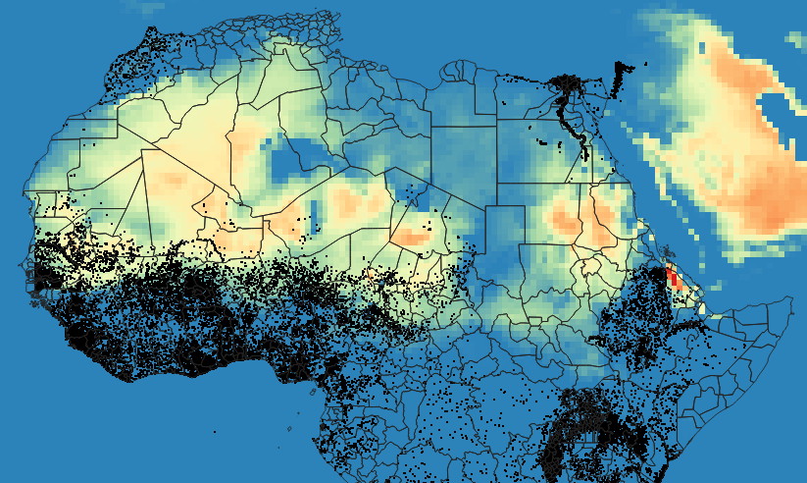

Climate + DHS data: Number of Heatdays
Legend:
Number of Heatdays (>40°) in 2004
Households in DHS

Slide 7
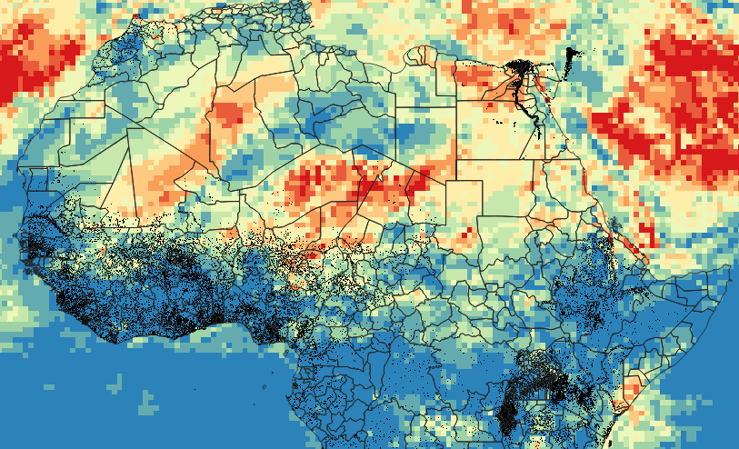
Climate + DHS data: Warm Spell Index
Legend:
Warm Spell index in 2004
(>6 consecutive days with temperature greater than 40°)
28
0
Households in DHS

Slide 8
Questions
Which shocks should we prioritize addressing at this stage of the paper?
How should we manage the inherent noise in the GPS coordinates obtained from the DHS?
Is it advisable to assess the magnitude of each shock at this stage of analysis?
What forms of heterogeneity analysis should we consider relevant for inclusion in the data cleaning process at this stage?
Which control variables should we consider relevant for inclusion in the data cleaning process at this stage?

Slide 9
Updates
(Work done during Late April-Early June)

Slide 10
Empirical Strategy

Slide 11
Empirical Strategy
Estimated for each period p conditional on survival to p-1, where:
D is a dummy variable equal to 1 if the child i living in cell c born in year y and in month m died. This dummy is multiplied by 1,000 to reflect mortality rates per 1,000 children instead of probability in the estimates.
P and T are the precipitation (SPI) and temperature indicates of the cell at the period rho (each quarter in utero and until the first age).
X is a set of controls including child gender, multiple birth indicator, birth order, age of mother (cubic), years of maternal education (cubic), rural indicator and wealth index quintile.
Delta are fixed effects for cell-month (for stationarity) and gamma are linear trends on every cell (for long-run trends).

Slide 12
Empirical Strategy
Prefered specification:
Add squared precipitation and temperature. We expect children to be impacted by extraordinarily low or high precipitation. We try to capture this non-linearities with a quadratic specification.
Alternative specification 2:
Define droughts and excessive rain as binary treatments. Defining a binary variable equal to one if SPI is greater than a threshold k could capture these non-linearities while simplifying the specification and making results more interpretable.

Slide 13
Data processing

Slide 14
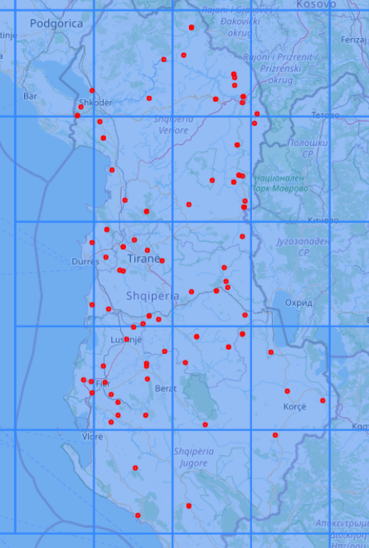
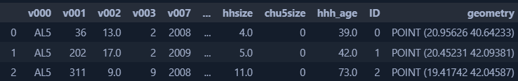
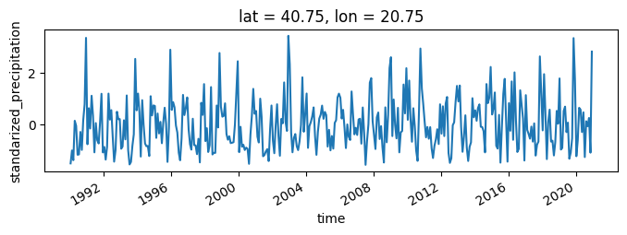
Assign spatial climate data DHS
We first assign each DHS observation to a single cell of the grid with the climate data
DHS data
Climate data

Slide 15
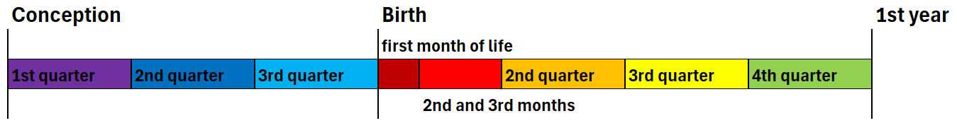
2) Create exposure variables
Weather exposure is divided into 8 periods, replicating Baird, Friedman & Simtz.
If a certain shock ocurred in the cell the households currently lives, in any of the months of each period, then the variable {shock}_{period} is equal to 1.

Slide 16
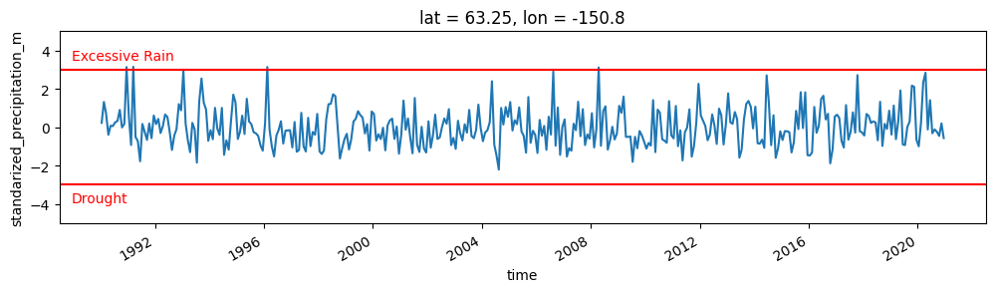
2) Create exposure variables
For a given period, we identify a drought if, during any its months, the SPI is lower than k.
Likewise, we identify an excessive rain if, during any of its months, the SPI is greater than k.
We also considered the Standardized Precipitation Index (SPI) for different time frames, as a drought may require several months with minimal rainfall to develop. Climatologists typically use SPI-1, SPI-3, SPI-6, and SPI-12 for such assessments.
Example of exposure variables for SPI-1 and k=2.5

Slide 17
3) Create cell identifiers
Number of observations in each cluster of cell#month, with different cell sizes
We constructed IDs for each cell.
As some cells had only a few households, we combined them into groups of 4 (2x2, cells of 1° by side, ~100km), 16 (4x4, cells of 2°) and 64 (8x8, cells of 4°) to see how results might vary.
 | Ungrouped | Groups of 4 cells | Groups of 16 cells | Groups of 64 cells
Grid size (side) | 0.5° | 1° | 2° | 4°
Size in km | 50x50km | 100x100km | 200x200km | 400x400km
Number of children
Less than 5 | 15.3% | 9.1% | 5.1% | 2.6%
Less than 10 | 30.5% | 18.1% | 9.9% | 6.6%
Less than 20 | 47.6% | 30.0% | 16.4% | 10.7%
Less than 30 | 57.8% | 37.8% | 20.5% | 13.4%
Less than 40 | 65.0% | 43.5% | 24.0% | 15.7%
Less than 50 | 70.5% | 48.2% | 27.1% | 17.1%
Less than 100 | 84.8% | 62.7% | 39.8% | 23.8%

Slide 18



reghdfe implementation in Julia
Initially, we started working with Stata's reghdfe command. For such a big dataset, with many FE, each single regression took about 20 minutes.
We've reimplemented the STATA script in Julia, so we can run these models on the GPU, making a x20 speed increase. This allows us to run more specifications, making the project feasible.
All our scripts are stored in a GitHub Repo that can be accessed here.

Slide 19
What regressions we've run
With the Julia's implementation, we were able to run the full set of stepped-regressions, for the combined cell sizes, shocks definitions and time horizons.
These models where run for all countries in the DHS pooled, for countries grouped by its income groups and for individual countries.
In the results section, we present the specification we think is more reasonable while producing significant results. In many cases there were no consistent effects of either precipitation or shocks on mortality. All the results can be accessed here.
4 cell sizes
(0.5°, 1°, 2°, 4°)
3 shock definitions
(1.5std, 2std, 2.5std)
4 SPI time horizons (1, 3, 6 or 12 months)
4 specifications
(lin., quad., dummy)

Slide 20
Descriptive statistics

Slide 21
Descriptive statistics
VARIABLES | Mean | SD | Min | P10 | P50 | P90 | Max
IMR in the first 30 days of life | 31.97 | 175.9 | 0 | 0 | 0 | 0 | 1,000
IMR between 30 days and 3 months of life | 5.18 | 71.8 | 0 | 0 | 0 | 0 | 1,000
IMR between 3 and 6 months of life | 5.38 | 73.1 | 0 | 0 | 0 | 0 | 1,000
IMR between 6 and 12 months of life | 10.49 | 101.9 | 0 | 0 | 0 | 0 | 1,000
Standarized Precipitation Index 1stQ in Utero | -0.025 | 0.641 | -3.09 | -0.83 | -0.03 | 0.79 | 3.09
Standarized Precipitation Index 2ndQ in Utero | -0.014 | 0.646 | -3.09 | -0.82 | -0.02 | 0.80 | 3.09
Standarized Precipitation Index 3rdQ in Utero | -0.025 | 0.638 | -3.09 | -0.83 | -0.03 | 0.78 | 3.09
Standarized Precipitation Index 0-30 days | -0.029 | 0.973 | -3.09 | -1.25 | -0.05 | 1.22 | 3.09
Standarized Precipitation Index 1-3 months | -0.029 | 0.741 | -3.09 | -0.96 | -0.04 | 0.91 | 3.09
Standarized Precipitation Index 3-6 months | -0.020 | 0.637 | -3.09 | -0.82 | -0.03 | 0.79 | 3.09
Standarized Precipitation Index 6-12 months | -0.027 | 0.476 | -2.576 | -0.63 | -0.03 | 0.58 | 3.09
Mean Temperature 1stQ in Utero | 23.97 | 5.599 | -25.19 | 17.32 | 25.08 | 29.62 | 38.21
Mean Temperature 2ndQ in Utero | 24.13 | 5.709 | -25 | 17.44 | 25.23 | 29.95 | 38.10
Mean Temperature 3rdQ in Utero | 24.32 | 5.831 | -25.82 | 17.43 | 25.41 | 30.50 | 37.96
Mean Temperature 0-30 days | 23.66 | 5.998 | -69.18 | 16.28 | 24.88 | 29.75 | 38.83
Mean Temperature 1-3 months | 23.90 | 5.747 | -26.34 | 16.96 | 25.04 | 29.72 | 38.46
Mean Temperature 3-6 months | 23.99 | 5.608 | -25.74 | 17.33 | 25.10 | 29.65 | 38.21
Mean Temperature 6-12 months | 24.91 | 5.487 | -21.97 | 18.56 | 25.88 | 30.67 | 38.10

Slide 22
Descriptive statistics
VARIABLES | Mean | SD | Min | Max
Affected by Drought 1stQ in Utero (SPI1 <1.5std) | 1.08% | 0.103 | 0 | 1
Affected by Drought 2ndQ in Utero (SPI1 <1.5std) | 1.06% | 0.103 | 0 | 1
Affected by Drought 3rdQ in Utero (SPI1 <1.5std) | 1.02% | 0.100 | 0 | 1
Affected by Drought 0-30 days (SPI1 <1.5std) | 6.06% | 0.239 | 0 | 1
Affected by Drought 1-3 months (SPI1 <1.5std) | 2.18% | 0.146 | 0 | 1
Affected by Drought 3-6 months (SPI1 <1.5std) | 1.02% | 0.101 | 0 | 1
Affected by Drought 6-12 months (SPI1 <1.5std) | 0.11% | 0.034 | 0 | 1
Affected by Ex. Rain 1stQ in Utero (rain >1.5std) | 1.10% | 0.104 | 0 | 1
Affected by Ex. Rain 2ndQ in Utero (rain >1.5std) | 1.26% | 0.111 | 0 | 1
Affected by Ex. Rain 3rdQ in Utero (rain >1.5std) | 1.14% | 0.106 | 0 | 1
Affected by Ex. Rain 0-30 days (rain >1.5std) | 6.08% | 0.239 | 0 | 1
Affected by Ex. Rain 1-3 months (rain >1.5std) | 2.24% | 0.148 | 0 | 1
Affected by Ex. Rain 3-6 months (rain >1.5std) | 1.08% | 0.103 | 0 | 1
Affected by Ex. Rain 6-12 months (rain >1.5std) | 0.16% | 0.040 | 0 | 1

Slide 23
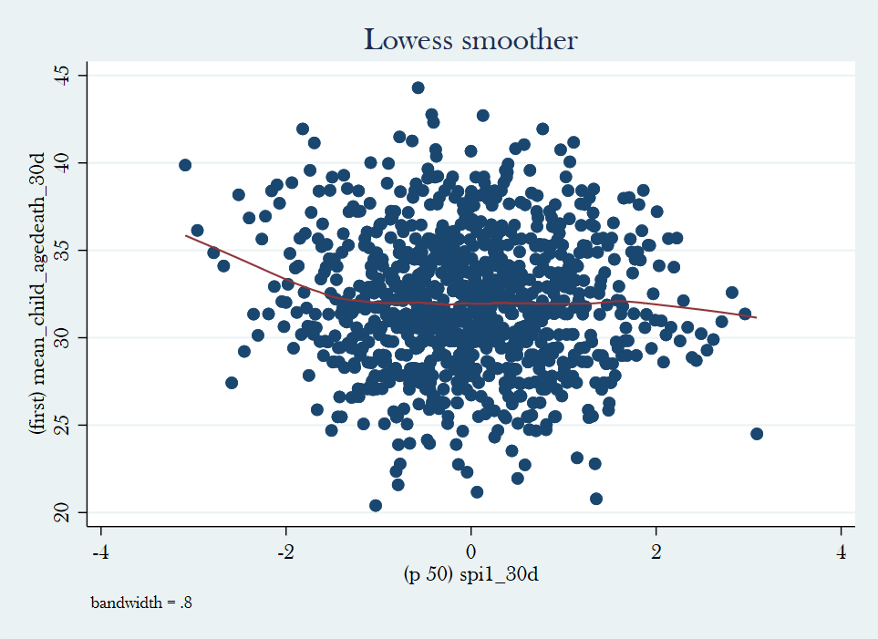
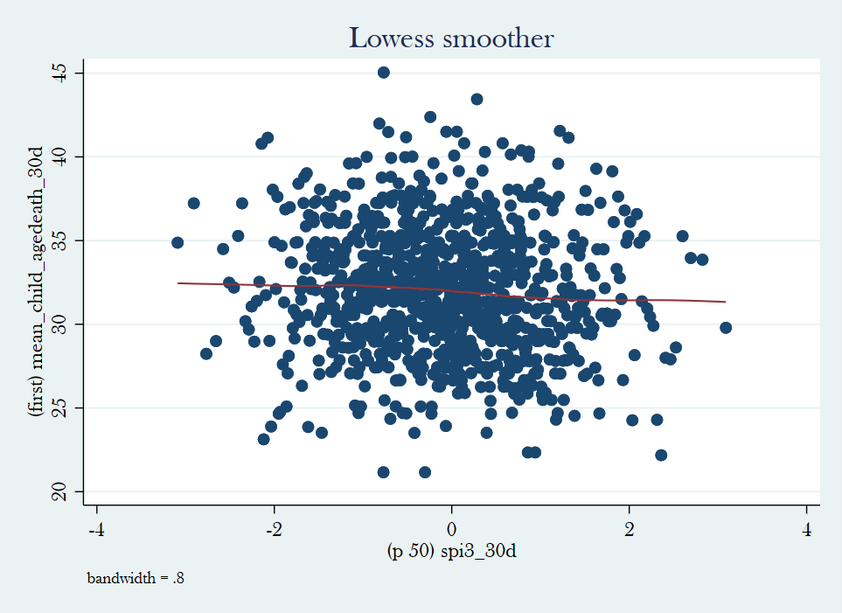
Bi-variate associations
Non-parametric regressions of infant death and weather indicate possibility of relationship and suggest functional form
Take into account that between –1 and 1, no effects are expected!
SPI-1
SPI-3
Drought
Excessive Rain
Drought
Excessive Rain
IMR
IMR
SPI-1 Drought might
be promising
SPI-1 in the first month of life
SPI-3 in the first month of life

Slide 24
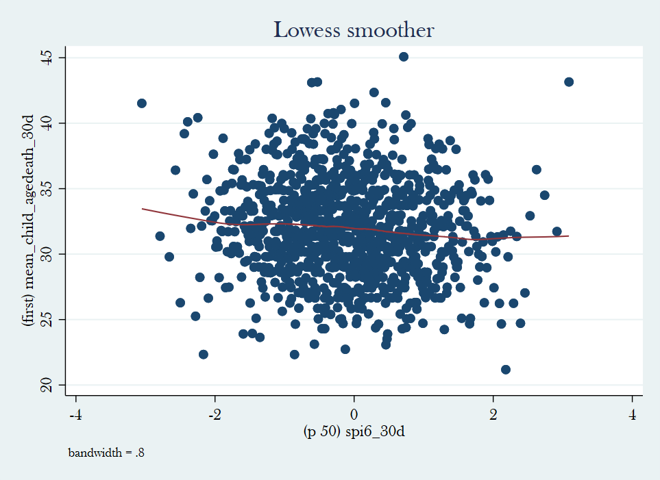
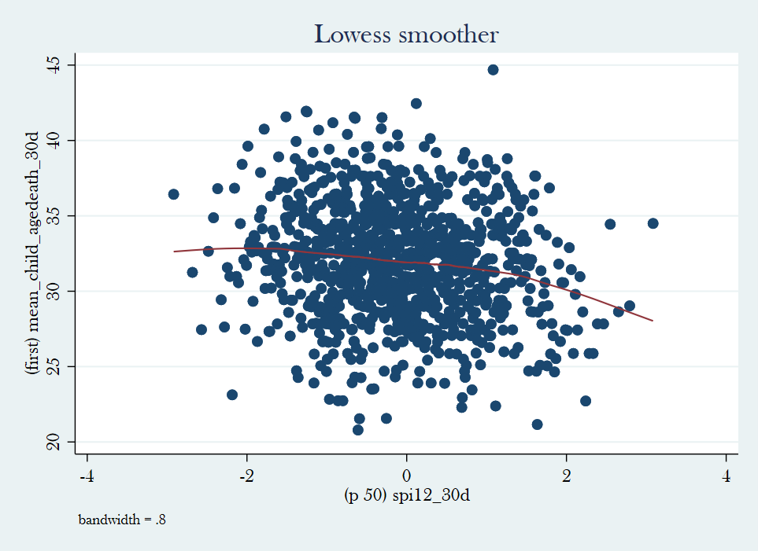
Bi-variate associations
Non-parametric regressions of infant death and weather indicate possibility of relationship and suggest functional form
Take into account that between –1 and 1, no effects are expected!
SPI-6
SPI-12
Drought
Excessive Rain
Drought
Excessive Rain
IMR
IMR
SPI-6 in the first month of life
SPI-12 in the first month of life

Slide 25
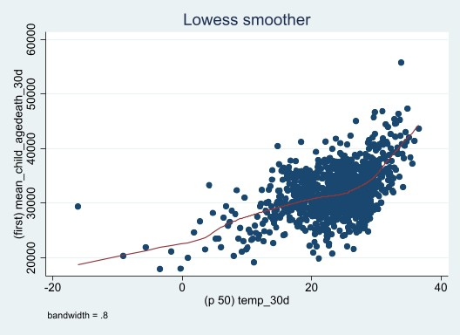
Bi-variate associations
Non-parametric regressions of infant death and weather indicate possibility of relationship and suggest functional form
Temperature
60
50
40
IMR
30
20
Temperature (C°)
Maybe a linear/quadratic specification might work here

Slide 26
Results:
Quadratic specification, SPI-1, all cell-sizes

Slide 27
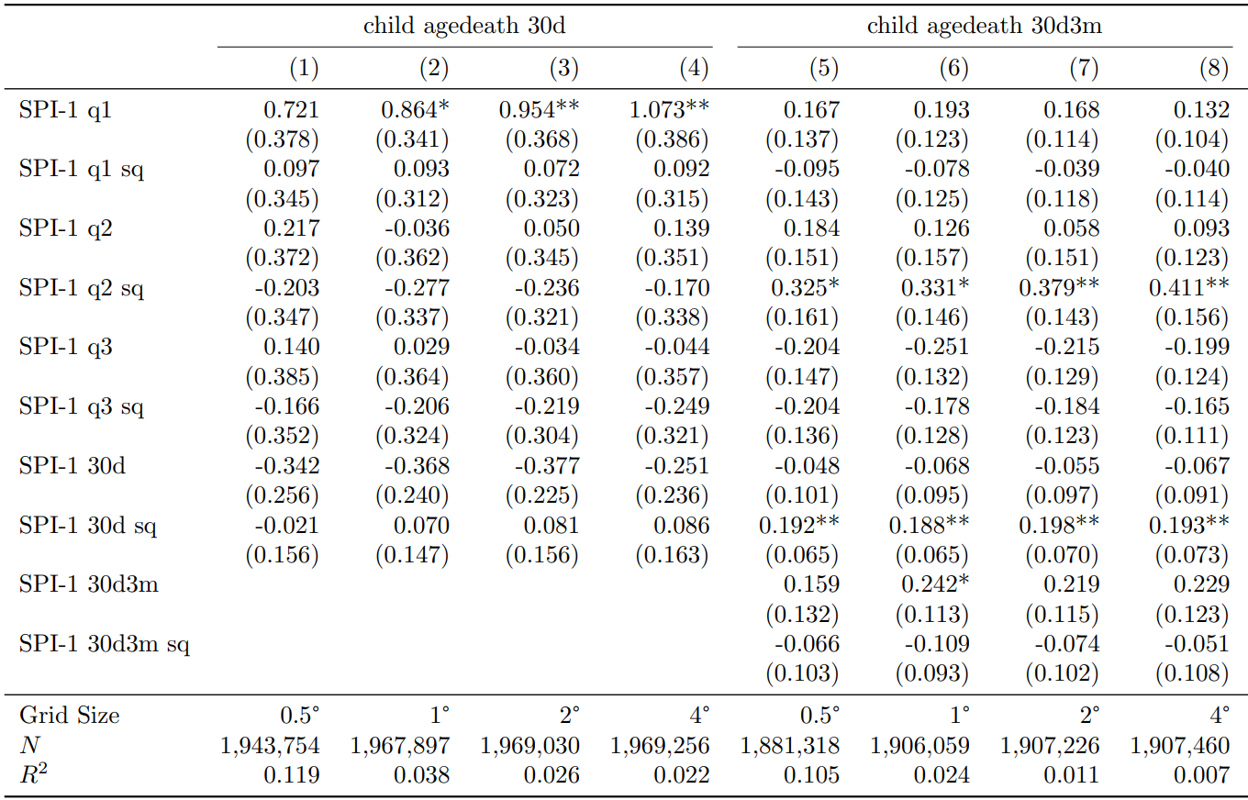
Results for Precipitation
A month with
precipitation 2SD higher than historical
average produces
2.1 more death per 1,000 children
IMR in the first 30 days of life​
IMR between 30d and 3m of life​
The IMR between 30d-3m is 5.18 per 1,000 children
The IMR in the first 30 days is 5.38 per 1,000 children
A month with precipitation 2SD higher or lower than historical average produces 1.6 more death per 1,000 children

Slide 28
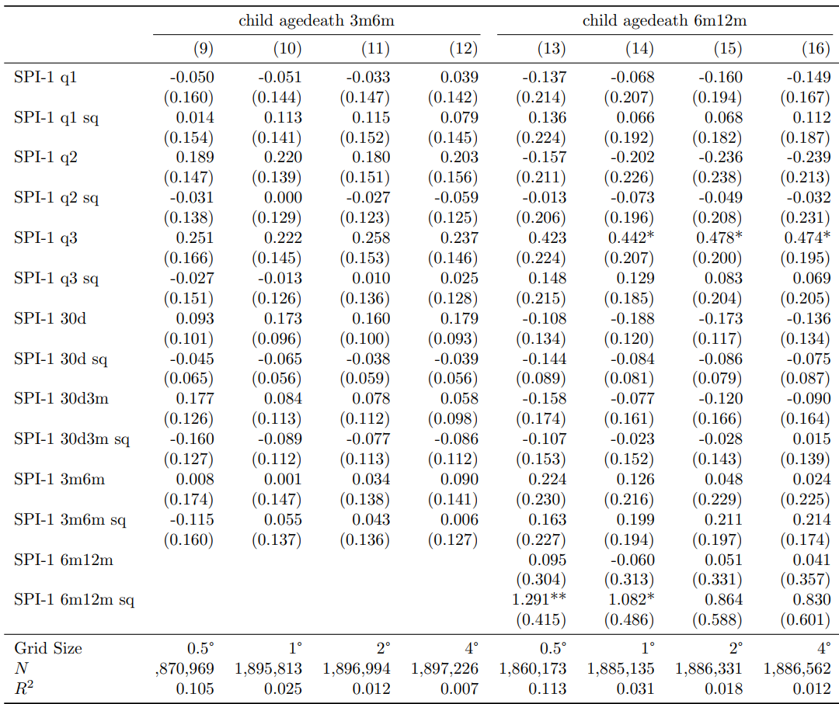
Results for Precipitation
IMR between 3m and 6m of life​
IMR between 6m and 12m of life
The IMR between 30m-6m is 5.38 per 1,000 children
A month with precipitation 2SD higher than historical average produces 1 more death per 1,000 children
The IMR between 30d-3m is 10.49 per 1,000 children
A month with precipitation 2SD higher or lower than historical average produces 5 more death per 1,000 children
1

Slide 29
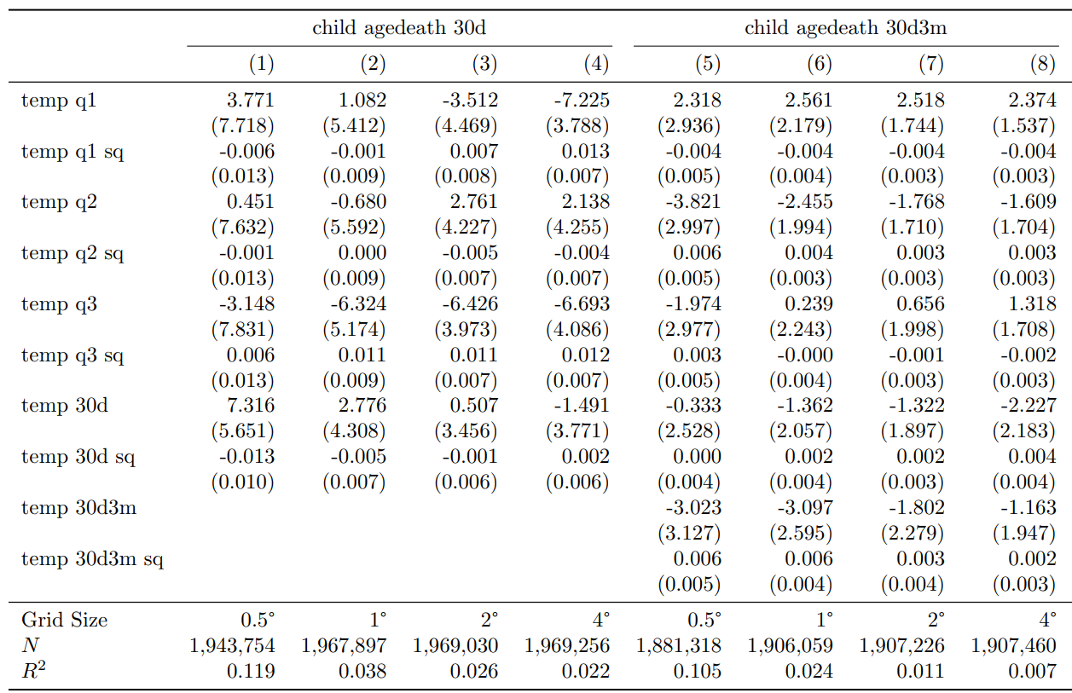
Results for Temperature
Nothing significant over here...
IMR in the first 30 days of life​
IMR between 30d and 3m of life​

Slide 30
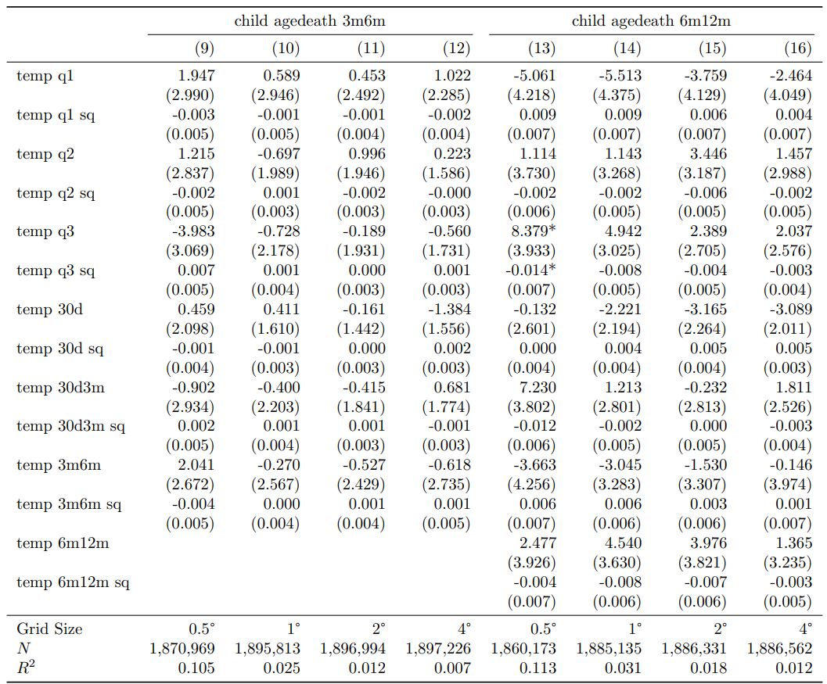
Results for Temperature
IMR between 3m and 6m of life​
IMR between 6m and 12m of life
A month with
precipitation 2SD higher than historical
average produces
2.1 more death per 1,000 children
A month with temperature 2SD higher or lower than historical average produces 1.6 more death per 1,000 children

Slide 31
Other things we tried and didn't worked
Alternative Fixed Effects and Time trend definition
Country FE instead of cell FE (also for the time trend)
Decade instead of year for the interaction (cell#decade instead of cell#year)
Removing linear time trend from the regression
Alternative specifications
Linear model
Dummy model
Dummy (precipitation) + Linear (temperature) model
SPI time horizons
SPI-1, SPI-3, SPI-6 and SPI-12. Only SPI-1 yielded the expected results.
Reduced set controls (no quadratic and cubic terms)
Estimation by income group and country

Slide 32

Other things we tried and didn't worked
To analyze the full set of results and select a specification, we've constructed an Excel file that summarizes all of them and helps explore the data.
This file allows the user to filter the models on each of the options (FE, controls, thresholds, months, etc.) and see how many estimates are significant on each specification, the sign of those estimates and how consistent they are within each selection
This excel file can be accesed here

Slide 33
Questions and extensions
We could analize the current results a bit deeper, to understand better which countries explain more these results and which do not.
Standardize Temperature: How should we standardize temperature to consider climate change? Taking the average of past 30 years might work?
Temperature shocks: We might want to consider focusing on temperature using varying thresholds.
Weights: currently we used the weights without taking into account the stratification sampling desing... Any ideas on how to overcome this?
Heterogenity Analysis. What types of heterogeneity analysis should we prioritize?

